Slide 1
Physical networks

Slide 2
Now that we have spent several weeks on the software that makes networks tick. Lets spend some time looking at physical networks!

Slide 3
Network Topology

Slide 4
What is Topology?
Topology
The arrangement and interlinking of computers in a computer network
dictionary.com

Slide 5
Factors of a topology
Cost
Flexibility
Reliability
Scalability
Ease of installation
Ease of maintenance.

Slide 6

Bus Topology
Data travels in both directions along the bus
All devices are connected to the bus
When device wants to transmit packet, destination address has to be included in the header.
Advantages
Easy to install
Can be extended easily
Very reliable because of single transition line
Disadvantages
Troubleshooting is difficult as there is not single point of control
One faulty node can being the while network down
Dumb terminals cannot be connected to the bus

Slide 7
Ring Topology
Each node is connected to exactly 2 other nodes
Data travels in one, predetermined, direction
Only one token allowed
Sender submits a packet
Neighbouring node transmits it to its neighbour and so on
Eventually, packet reaches the destination and is removed
Or
Packet reaches sender and is removed.
Advantages
Small cable segments
Ideal for optical fibre as data travels in only one direction
Very high transition speeds possible.
Disadvantages
Failure of single node brings down the whole network
Troubleshooting is difficult as many nodes may have to be inspected before problem is identified.
Difficult to remove one or more nodes while keeping the network operational.

Slide 8
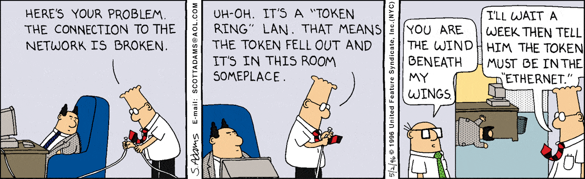

Slide 9
Star Topology
All Nodes are connected to central server
Server is responsible for passing on all communications
Possibly the most common topology
Advantages
Failure a node dose not affect the network
Trouble shooting is easy as faulty node can be detected from central point
Simple access protocols required as one of the communicating nodes is always the server.
Disadvantages
Longer cables to connect to server
Failure of central node brings whole network down.
Server

Slide 10
Tree Topology
Combination of star and bus topologies
Groups of star networks connected with a bus backbone
Advantages
Existing networks can be easily expanded
Point-to-point wiring for individual segments means easier installation and maintenance
Well suited for temporary networks
Disadvantages
Technical experience required to configure and wire tree
Failure of backbone brings down entire network
Maintenance difficult for large networks

Slide 11
Transmission Media

Slide 12
Guided
Transmitted data travels through cables and along known, fixed paths.
Unguided
Transmitted data travels through space in the form of electromagnetic waves.

Slide 13
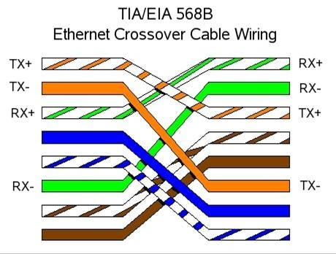
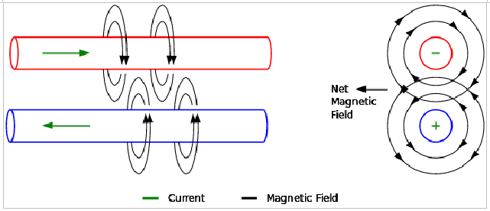
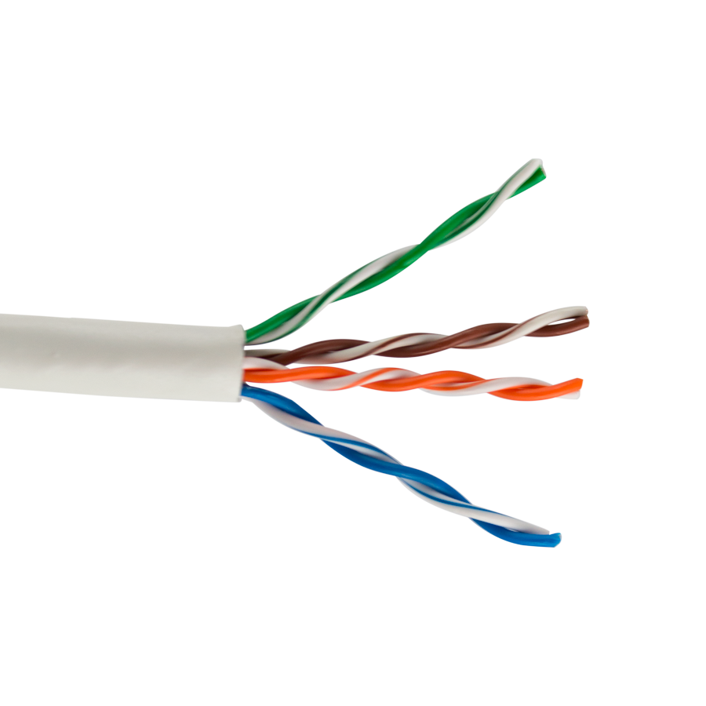
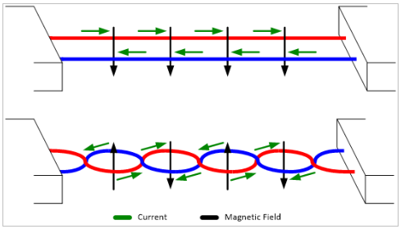
Twisted Pair Cable
Shielded and unshielded
Most common type of network cable
Supports 100 base T and 1000 base T (100 mb/s, 1000mb/s)
Twisted to reduce noise on the line from magnetic fields
Notes:
Most common type of data cable
Found in most networks. Its in this room, my house, probably your house (if you wired your computers to your modem).
4 sets to twisted wires. Twisted to reduce noise on the line from magnetic fields.
STOP! Physics time!
Magnetic fields are generated when electrons flow through circet.
They follow the “left hand rule”. Magnetic fields rotate clockwise as electrons flow away from you.
If you have 2 fields, next to each other, rotating clockwise and counter clockwise, then the net field has a direction away from the cable.
If another magnetic field comes along (imagine a magnet) then its field affects the field of the cable but only in one location. This move the magnet around a bit and you can artificially drag the data line high and low. This would affect the data we are passing and mess up our data. Not what we want.
How ever if we twist the wires around each other, we end up with alternating magnetic fields all the way along the cable.
Now when we move the magnet, we pall the line high in one location but pull it low in the another location (depending on the twist). The high is the invers of the low and the to cancel out, leaving us with just our data…. Electrical engineers are smart buggers ☺
Cat5e and cat6 comes with more shielding to help further reduce interference. It always reminded me if tinfoil.
But, for all its graces, Cat5, 5e and 6 are a nightmare to wire yourself.

Slide 14
UTP/STP
Cat5 = 100 mb/s
Cat5e = 1000 mb/s
Cat6 = 10,000 mb/s
these are the theoretical maximum speeds and distance please a factor. In more situations, you should get reasonable close to these numbers.

Slide 15
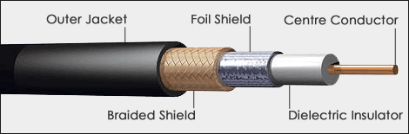
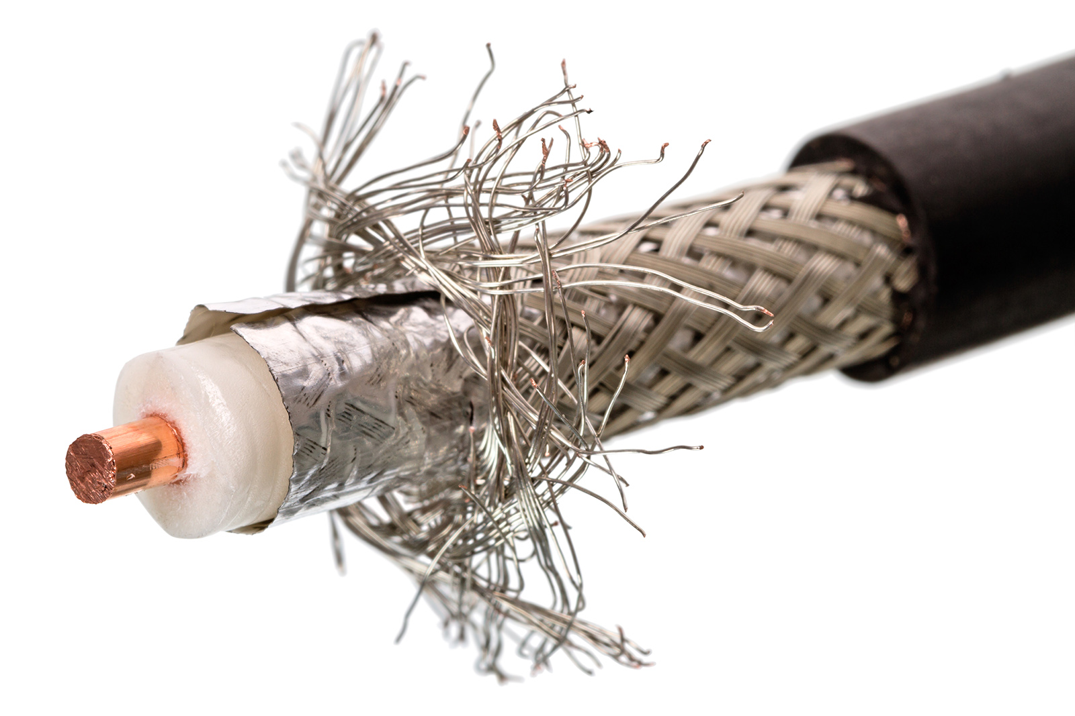
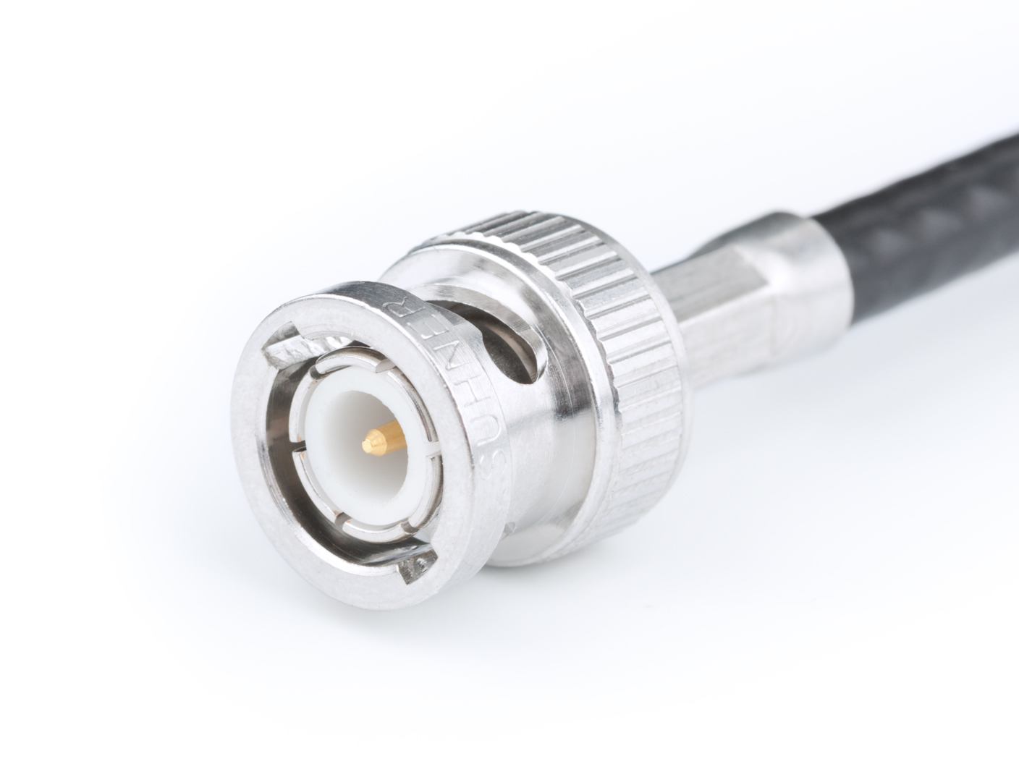
Coaxial Cable
10 baseT = 10mb/s

Slide 16
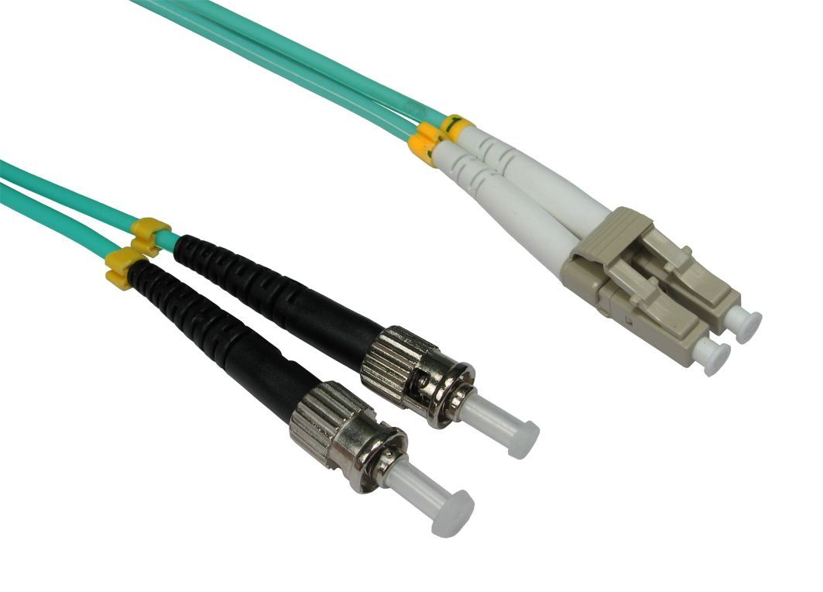
Optical
Advantages
Fast, really fast
Disadvantages
Expensive
Easy to break

Slide 17
Hardware

Slide 18
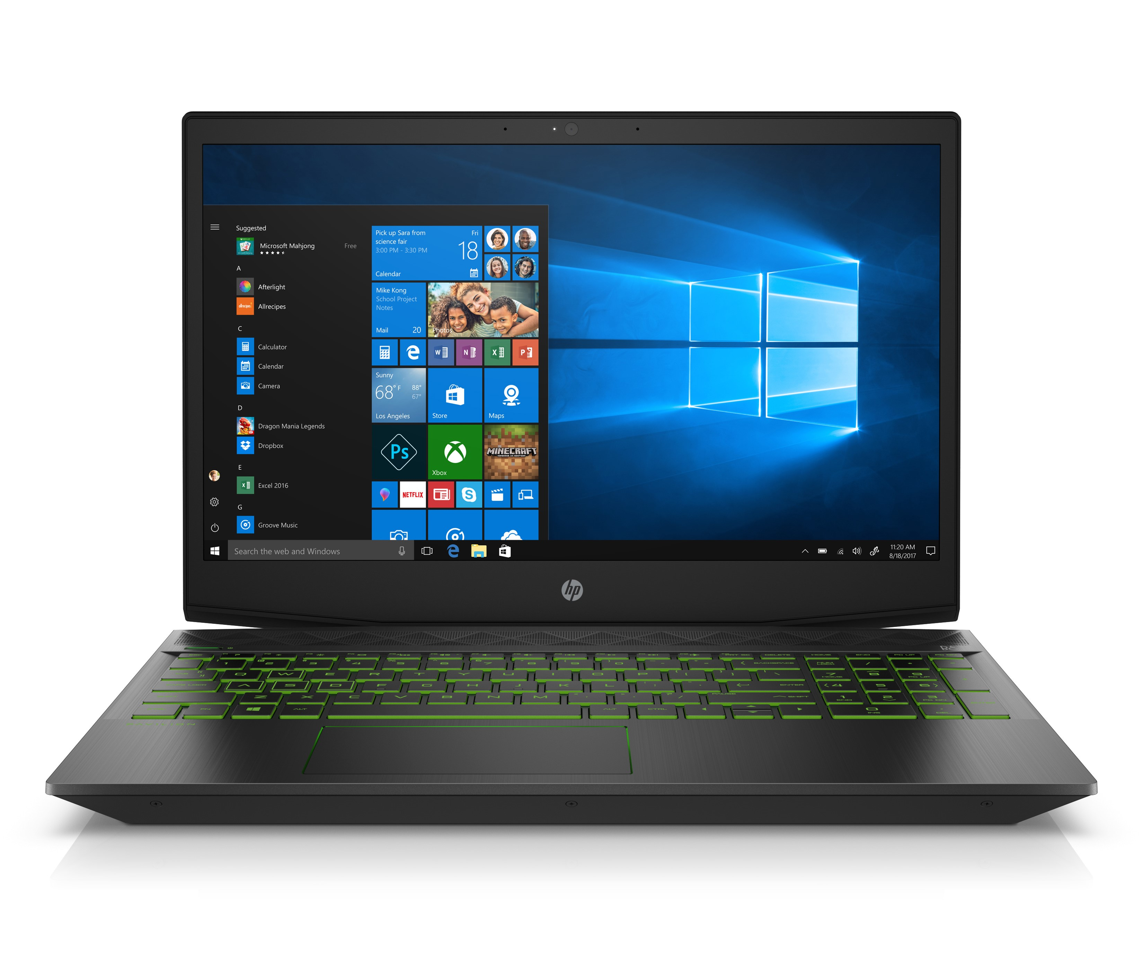
Computer
We all know what these things are
Sometime there consumer grade
Some times there servers

Slide 19
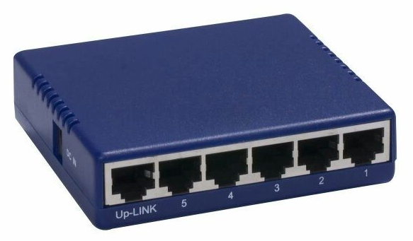
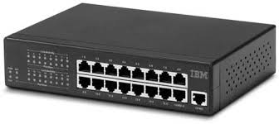
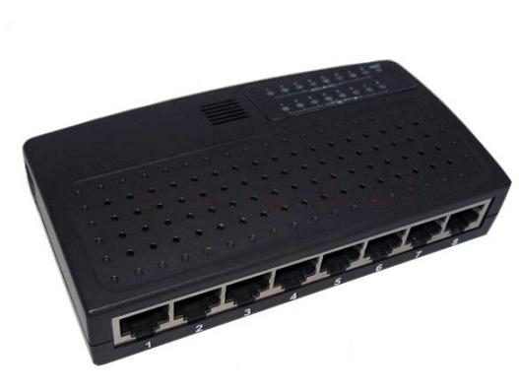
Hubs
Operates at layer 1 of the OSI model
Can support 10 to 1000 mb/s
Largely obsolete
Can cause packet collisions as hubs send packets to all connected device.

Slide 20
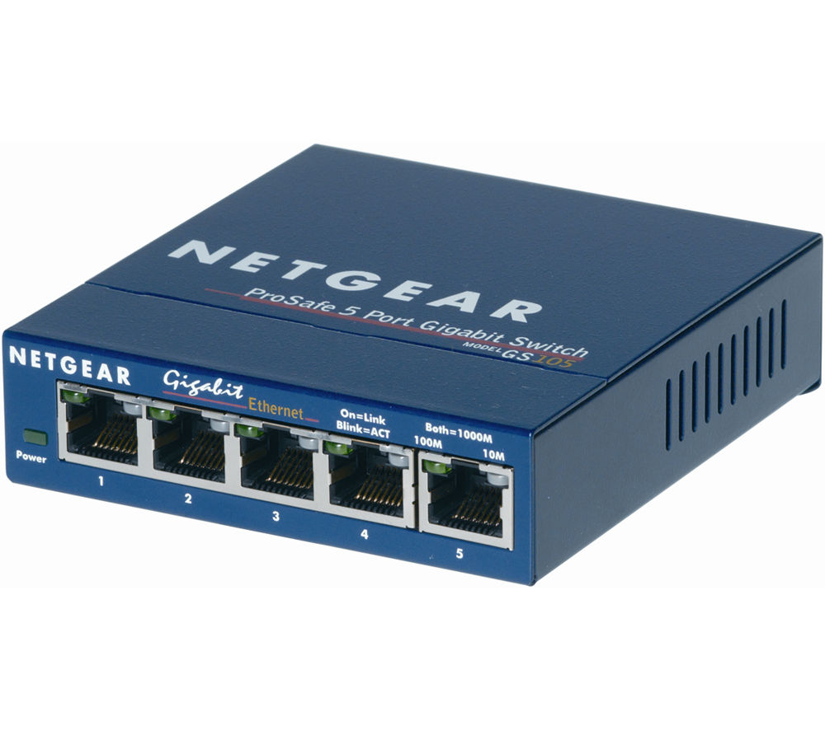
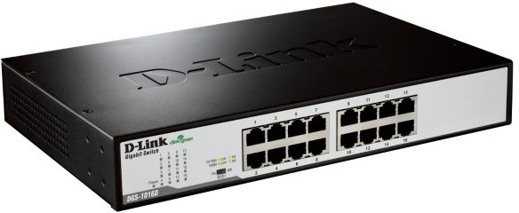
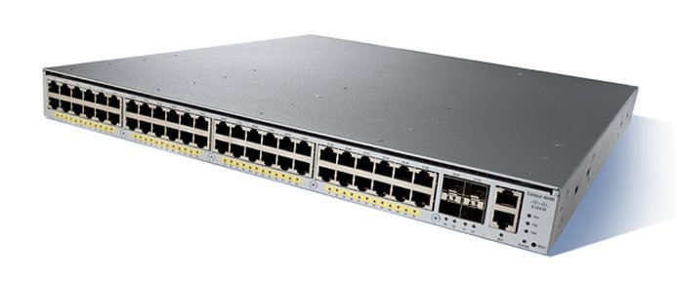
switches
Notice a difference?
You can be forgiven if you cant
Switches are almost the same as hubs
More intelligent as they send packets to the correct device, based on mac address
More common that hubs now

Slide 21
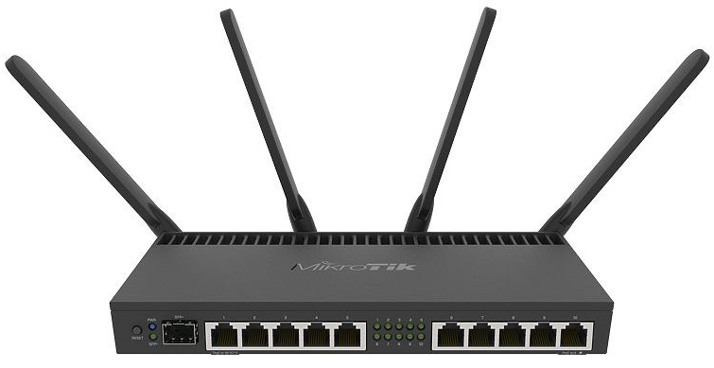
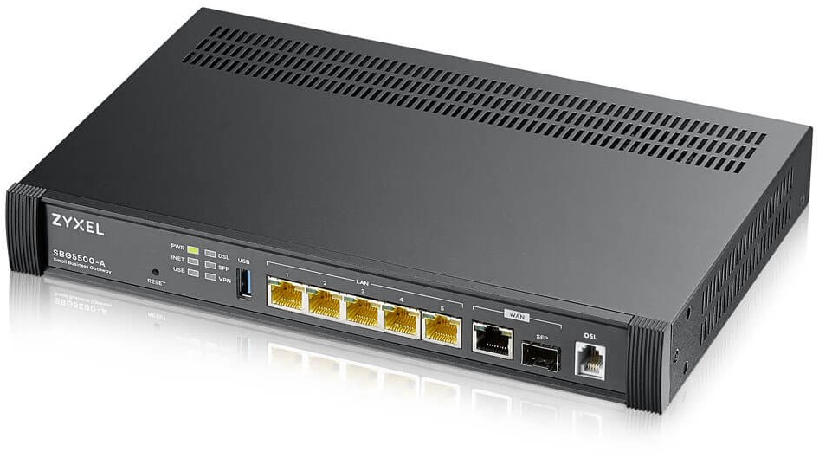
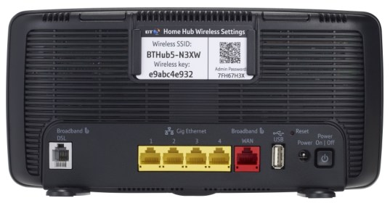
Router
Network device that forwards packets between networks.
Can have switch built in but not necessary
May include firewall, VPN

Slide 22
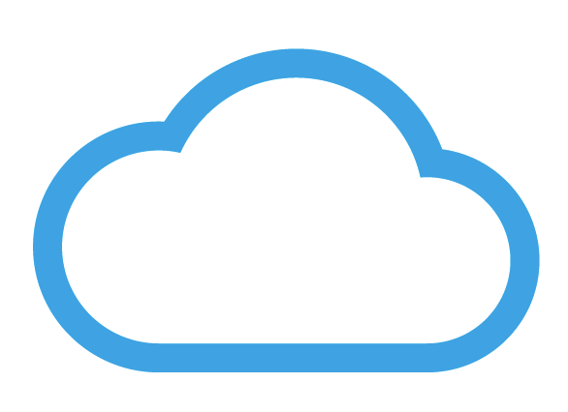
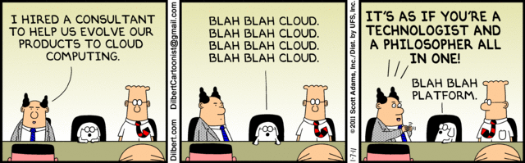
The Cloud
Not hardware
It’s a general idea of things that exist on the internet.
Its just servers
And services
IT IS NOT THE ANSWER!

Slide 23
Questions?

